Slide 1

Slide Deck 10
ECE 4203 VLSI Design

Slide 2
Outline
Introduction to SPICE
DC Analysis
Transient Analysis
Subcircuits
Optimization
Power Measurement
Logical Effort Characterization

Slide 3
Introduction to SPICE
Simulation Program with Integrated Circuit Emphasis
Developed in 1970’s at Berkeley
Many commercial versions are available
HSPICE is a robust industry standard
Has many enhancements that we will use
Written in FORTRAN for punch-card machines
Circuits elements are called cards
Complete description is called a SPICE deck

Slide 4
Writing Spice Decks
Writing a SPICE deck is like writing a good program
Plan: sketch schematic on paper or in editor
Modify existing decks whenever possible
Code: strive for clarity
Start with name, email, date, purpose
Generously comment
Test:
Predict what results should be
Compare with actual
Garbage In, Garbage Out!

Slide 5
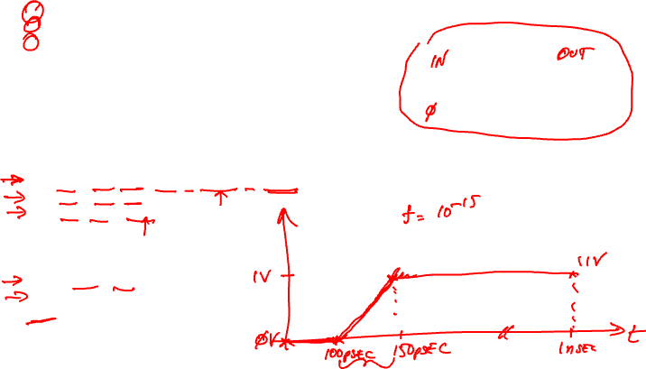
Example: RC Circuit
* rc.sp
* David_Harris@hmc.edu 2/2/03
* Find the response of RC circuit to rising input
*------------------------------------------------
* Parameters and models
*------------------------------------------------
.option post
*------------------------------------------------
* Simulation netlist
*------------------------------------------------
Vin in gnd pwl 0ps 0 100ps 0 150ps 1.0 1ns 1.0
R1 in out 2k
C1 out gnd 100f
*------------------------------------------------
* Stimulus
*------------------------------------------------
.tran 20ps 1ns
.plot v(in) v(out)
.end

Slide 6

Result (Graphical)

Slide 7
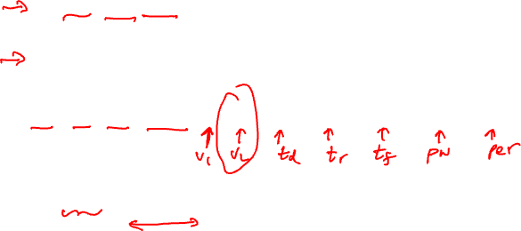
Sources
DC Source
Vdd vdd gnd 2.5
Piecewise Linear Source
Vin in gnd pwl 0ps 0 100ps 0 150ps 1.0 1ns 1.0
Pulsed Source
Vck clk gnd PULSE 0 1.0 0ps 100ps 100ps 300ps 800ps

Slide 8
SPICE Elements
Letter
Element
R
Resistor
C
Capacitor
L
Inductor
K
Mutual Inductor
V
Independent voltage source
I
Independent current source
M
MOSFET
D
Diode
Q
Bipolar transistor
W
Lossy transmission line
X
Subcircuit
E
Voltage-controlled voltage source
G
Voltage-controlled current source
H
Current-controlled voltage source
F
Current-controlled current source

Slide 9
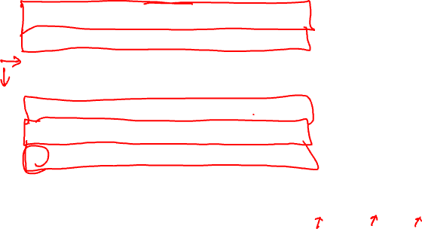
Units
Letter | Unit | Magnitude
a | atto | 10⁻¹⁸
f | fempto | 10⁻¹⁵
p | pico | 10⁻¹²
n | nano | 10⁻⁹
u | micro | 10⁻⁶
m | milli | 10⁻³
k | kilo | 10³
x | mega | 10⁶
g | giga | 10⁹
Ex: 100 femptofarad capacitor = 100fF, 100f, 100e-15

Slide 10
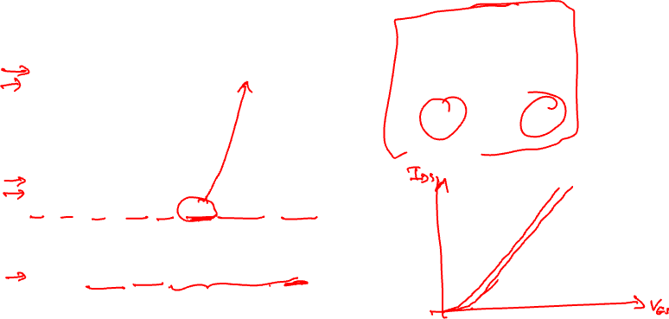
DC Analysis
* mosiv.sp
*------------------------------------------------
* Parameters and models
*------------------------------------------------
.include '../models/ibm065/models.sp'
.temp 70
.option post
*------------------------------------------------
* Simulation netlist
*------------------------------------------------
*nmos
Vgs g gnd 0
Vds d gnd 0
M1 d g gnd gnd NMOS W=100n L=50n
*------------------------------------------------
* Stimulus
*------------------------------------------------
.dc Vds 0 1.0 0.05 SWEEP Vgs 0 1.0 0.2
.end

Slide 11
I-V Characteristics
nMOS I-V
V_{gs} dependence
Saturation

Slide 12
0.18um Process – More Characteristics

Slide 13
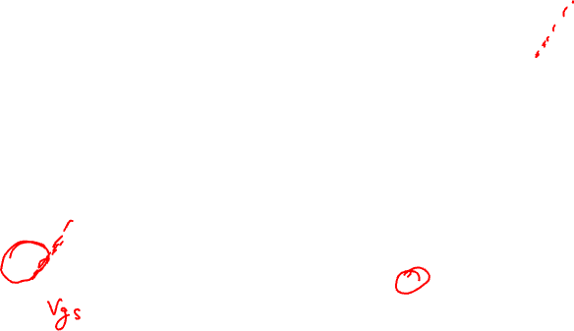
Linear Extrapolation of Threshold

Slide 14
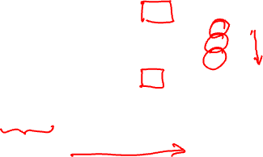
MOS Threshold Voltage

Slide 15
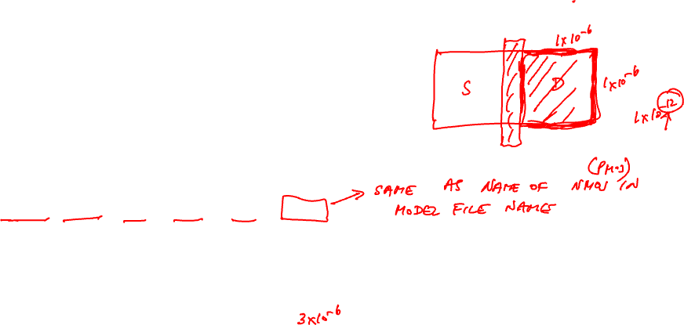
MOSFET Elements
M element for MOSFET
Mname drain gate source body type
+ W=<width> L=<length>
+ AS=<area source> AD = <area drain>
+ PS=<perimeter source> PD=<perimeter drain>

Slide 16
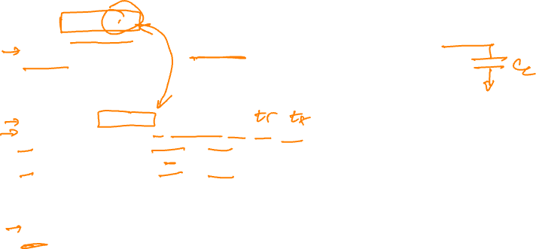
Transient Analysis
* inv.sp
* Parameters and models
*------------------------------------------------
.param SUPPLY=1.0
.option scale=25n
.include '../models/ibm065/models.sp'
.temp 70
.option post
* Simulation netlist
*------------------------------------------------
Vdd vdd gnd 'SUPPLY'
Vin a gnd PULSE 0 'SUPPLY' 50ps 0ps 0ps 100ps 200ps
M1 y a gnd gnd NMOS W=4 L=2
+ AS=20 PS=18 AD=20 PD=18
M2 y a vdd vdd PMOS W=8 L=2
+ AS=40 PS=26 AD=40 PD=26
* Stimulus
*------------------------------------------------
.tran 0.1ps 80ps
.end

Slide 17
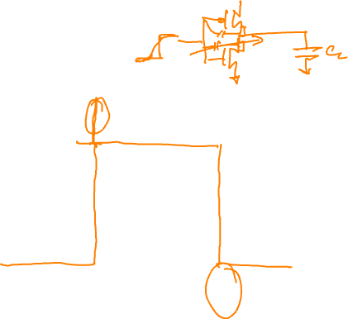
Transient Results
Unloaded inverter
Overshoot
Very fast
edges

Slide 18
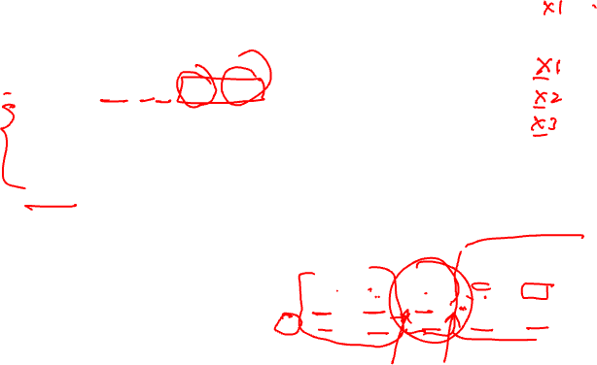
Subcircuits
Declare common elements as subcircuits
Ex: Fanout-of-4 Inverter Delay
Reuse inv
Shaping
Loading
.subckt inv a y N=4 P=8
M1 y a gnd gnd NMOS W='N' L=2
+ AS='N*5' PS='2*N+10' AD='N*5' PD='2*N+10'
M2 y a vdd vdd PMOS W='P' L=2
+ AS='P*5' PS='2*P+10' AD='P*5' PD='2*P+10'
.ends

Slide 19
FO4 Inverter Delay
* fo4.sp
* Parameters and models
*----------------------------------------------------------------------
.param SUPPLY=1.0
.param H=4
.option scale=25n
.include '../models/ibm065/models.sp'
.temp 70
.option post
* Subcircuits
*----------------------------------------------------------------------
.global vdd gnd
.include '../lib/inv.sp'
* Simulation netlist
*----------------------------------------------------------------------
Vdd vdd gnd 'SUPPLY'
Vin a gnd PULSE 0 'SUPPLY' 0ps 20ps 20ps 120ps 280ps
X1 a b inv * shape input waveform
X2 b c inv M='H' * reshape input waveform
.end

Slide 20

FO4 Inverter Delay Cont.
X3 c d inv M='H**2' * device under test
X4 d e inv M='H**3' * load
x5 e f inv M='H**4' * load on load
* Stimulus
*----------------------------------------------------------------------
.tran 0.1ps 280ps
.measure tpdr * rising prop delay
+ TRIG v(c) VAL='SUPPLY/2' FALL=1
+ TARG v(d) VAL='SUPPLY/2' RISE=1
.measure tpdf * falling prop delay
+ TRIG v(c) VAL='SUPPLY/2' RISE=1
+ TARG v(d) VAL='SUPPLY/2' FALL=1
.measure tpd param='(tpdr+tpdf)/2' * average prop delay
.measure trise * rise time
+ TRIG v(d) VAL='0.2*SUPPLY' RISE=1
+ TARG v(d) VAL='0.8*SUPPLY' RISE=1
.measure tfall * fall time
+ TRIG v(d) VAL='0.8*SUPPLY' FALL=1
+ TARG v(d) VAL='0.2*SUPPLY' FALL=1
.end

Slide 21
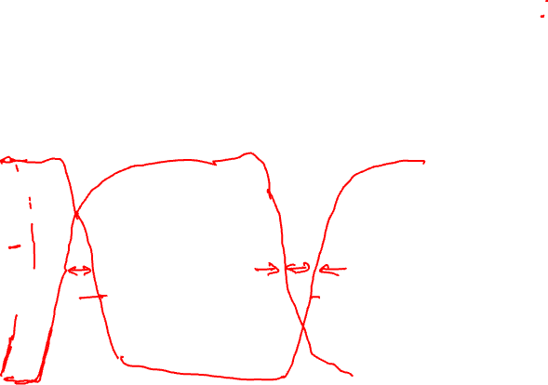
FO4 Results

Slide 22
Optimization
HSPICE can automatically adjust parameters
Seek value that optimizes some measurement
Example: Best P/N ratio
We’ve assumed 2:1 gives equal rise/fall delays
But we see rise is actually slower than fall
What P/N ratio gives equal delays?
Strategies
(1) run a bunch of sims with different P size
(2) let HSPICE optimizer do it for us

Slide 23
P/N Optimization
* fo4opt.sp
* Parameters and models
*----------------------------------------------------------------------
.param SUPPLY=1.0
.option scale=25n
.include '../models/ibm065/models.sp'
.temp 70
.option post
* Subcircuits
*----------------------------------------------------------------------
.global vdd gnd
.include '../lib/inv.sp'
* Simulation netlist
*----------------------------------------------------------------------
Vdd vdd gnd 'SUPPLY'
Vin a gnd PULSE 0 'SUPPLY' 0ps 20ps 20ps 120ps 280ps
X1 a b inv P='P1' * shape input waveform
X2 b c inv P='P1' M=4 * reshape input
X3 c d inv P='P1' M=16 * device under test

Slide 24
P/N Optimization
X4 d e inv P='P1' M=64 * load
X5 e f inv P='P1' M=256 * load on load
* Optimization setup
*----------------------------------------------------------------------
.param P1=optrange(8,4,16) * search from 4 to 16, guess 8
.model optmod opt itropt=30 * maximum of 30 iterations
.measure bestratio param='P1/4' * compute best P/N ratio
* Stimulus
*----------------------------------------------------------------------
.tran 0.1ps 280ps SWEEP OPTIMIZE=optrange RESULTS=diff MODEL=optmod
.measure tpdr * rising propagation delay
+ TRIG v(c) VAL='SUPPLY/2' FALL=1
+ TARG v(d) VAL='SUPPLY/2' RISE=1
.measure tpdf * falling propagation delay
+ TRIG v(c) VAL='SUPPLY/2' RISE=1
+ TARG v(d) VAL='SUPPLY/2' FALL=1
.measure tpd param='(tpdr+tpdf)/2' goal=0 * average prop delay
.measure diff param='tpdr-tpdf' goal = 0 * diff between delays
.end

Slide 25
P/N Results
P/N ratio for equal delay is 2.9:1
t_{pd} = t_{pdr} = t_{pdf} = 17.9 ps (slower than 2:1 ratio)
Big pMOS transistors waste power too
Seldom design for exactly equal delays
What ratio gives lowest average delay?
.tran 1ps 1000ps SWEEP OPTIMIZE=optrange RESULTS=tpd MODEL=optmod
P/N ratio of 1.8:1
t_{pdr} = 18.8 ps, t_{pdf} = 15.2 ps, t_{pd} = 17.0 ps
P/N ratios of 1.5:1 – 2.2:1 gives t_{pd} < 17.2 ps

Slide 26
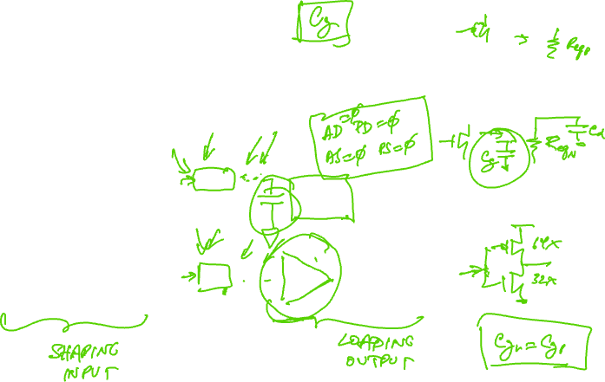
Circuit For Extracting Effective Gate Capacitance for Delay Estimation

Slide 27
SPICE Deck For Extracting Effective Capacitance for Delay Estimation

Slide 28
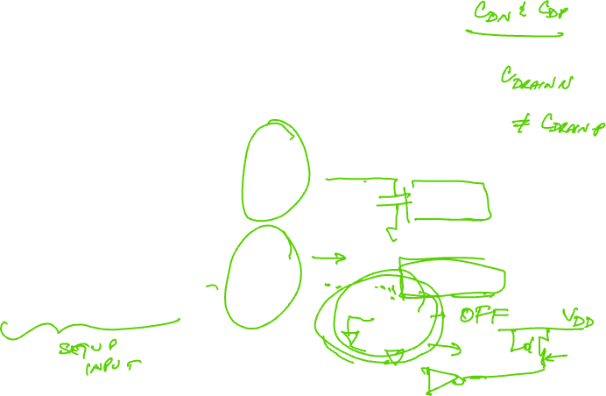
Circuit For Extracting Effective Parasitic Capacitance for Delay Estimation

Slide 29
Power Measurement
HSPICE can measure power
Instantaneous P(t)
Or average P over some interval
.print P(vdd)
.measure pwr AVG P(vdd) FROM=0ns TO=10ns
Power in single gate
Connect to separate V_{DD} supply
Be careful about input power

Slide 30
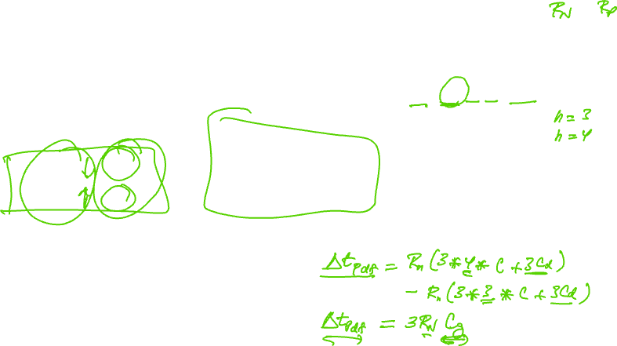
RC Delay For Fanout of h Inverter

Slide 31
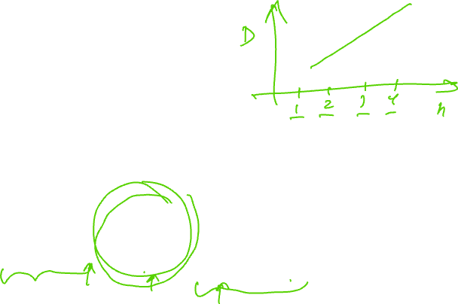
Logical Effort
Logical effort can be measured from simulation
As with FO4 inverter, shape input, load output

Slide 32
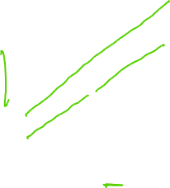
Logical Effort Plots
Plot t_{pd} vs. h
Normalize by τ
y-intercept is parasitic delay
Slope is logical effort
Delay fits straight line
very well in any process
as long as input slope is
consistent

Slide 33
Logical Effort Data
For NAND gates in IBM 65 nm process:
Notes:
Parasitic delay is greater for outer input
Average logical effort is better than estimated

Slide 34
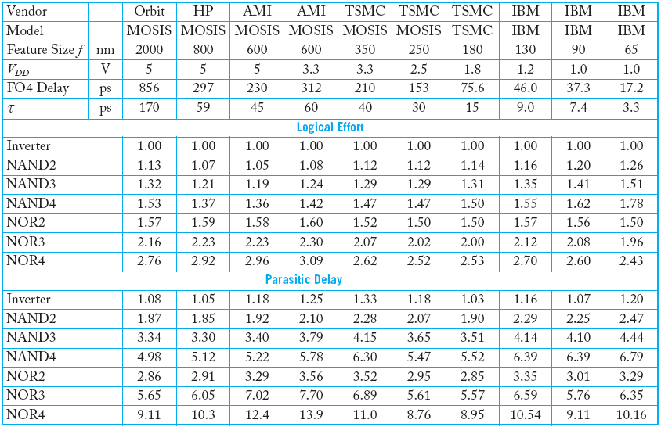
Comparison

